Slide 1

We are almost ready to start…
WELCOME!

Slide 2

NEW YORK
February 2027

Slide 3


Partner in education Thomas More TRM
New York February 2027
Organizing tour operator

Slide 4
WHO CAN REGISTER?
Only Thomas More students

Slide 5
General information
Not mandatory
You will not miss classes
Between two semesters
Teachers will join
Prices are depending on room type

Slide 6
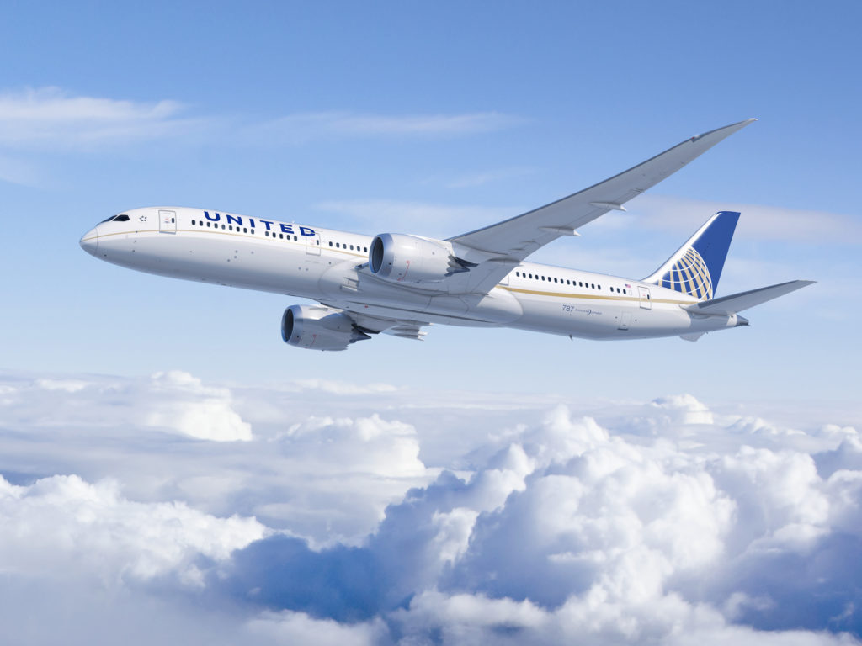
Flights
OUTBOUND 30 JAN
UA995 BRU-EWR
11.15-13.25
INBOUND 4 FEB
UA994 EWR-BRU
18.55-08.05 (5 FEB)
*Incl. 23kg luggage & taxes

Slide 7
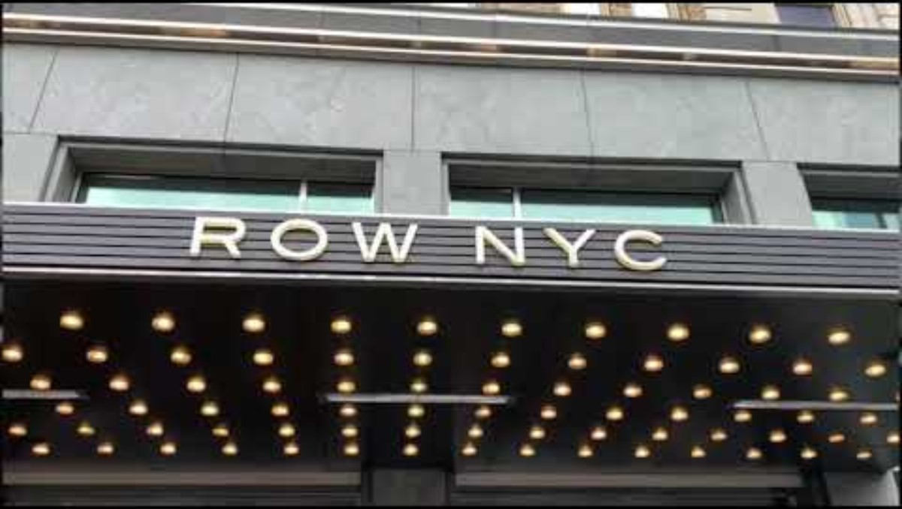
ACCOMMODATION
Row NYC Hotel
The energy of New York City begins the moment you arrive at Row NYC. Surrounded by the lights of Times Square and the excitement of Broadway, the hotel offers a modern retreat in the middle of Manhattan’s nonstop rhythm. Walk through iconic streets filled with culture, entertainment, and discovery, and end in thoughtfully redesigned guest rooms inspired by the craftsmanship of the Theater District.

Slide 8
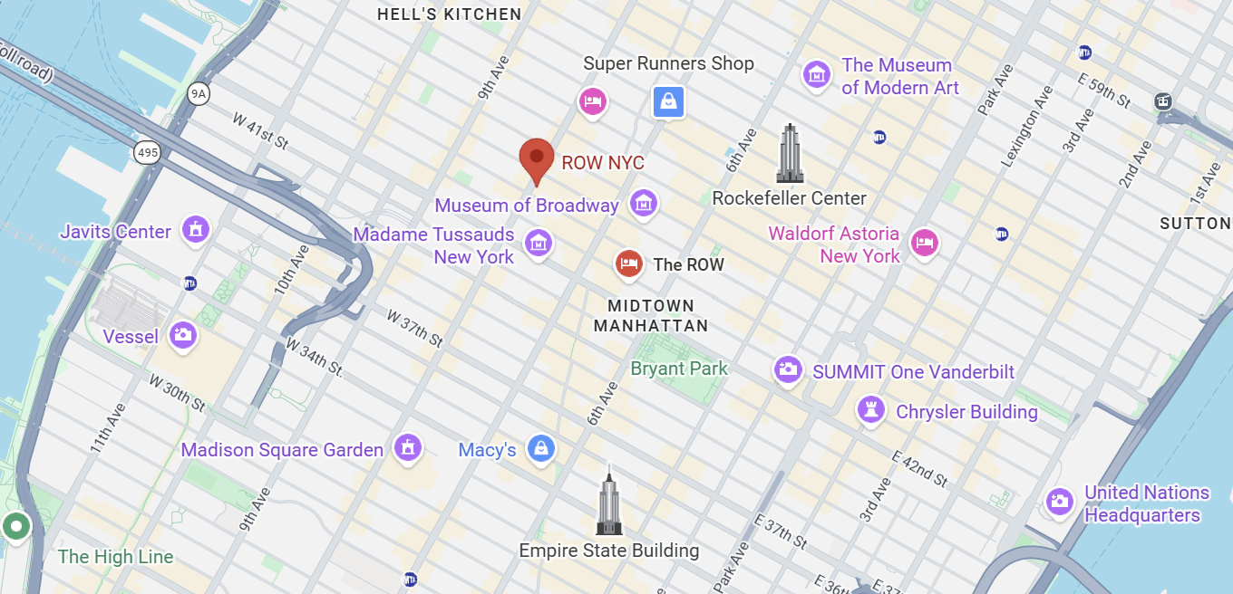
Location hotel:
700 8th Ave, New York, NY 10036, Verenigde Staten
+/- 1 km away from Empire State Building
+/- 0,4 km away from Times Square

Slide 9
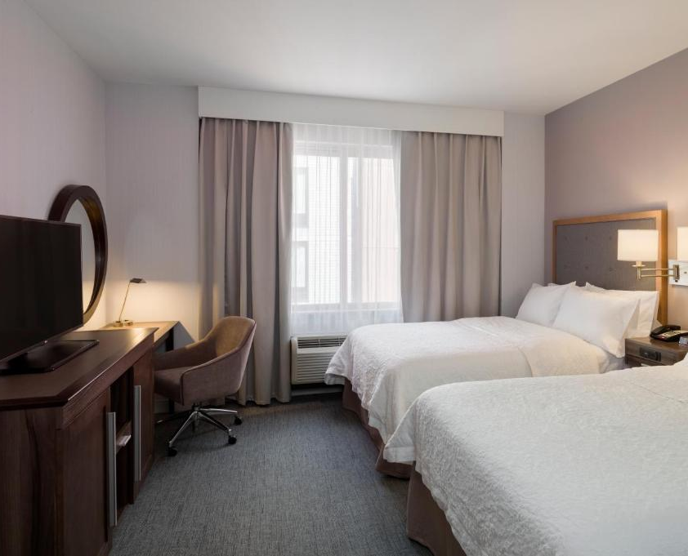
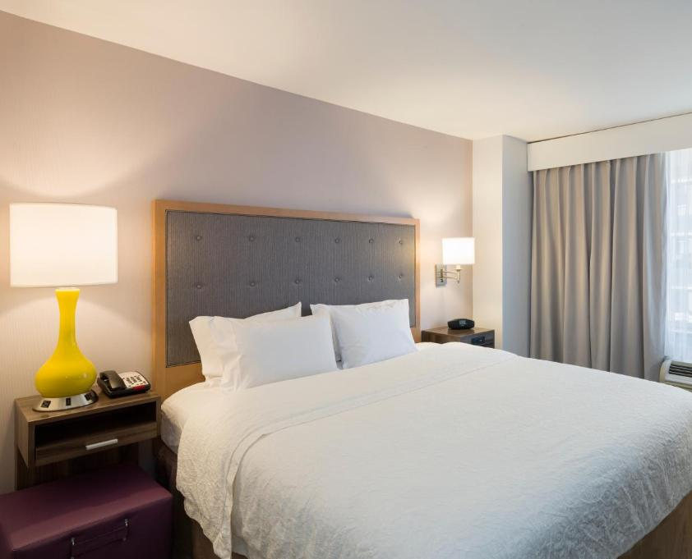
Bedroom types to choose FROM
Quad room (four persons – two double beds, 1m40)
Triple room (Three persons – two double beds, 1m40)
Double room (Two persons – two double beds or one kingsize bed 1m80)
Notes:
Smalle bedden 1m40 , samen inschrijven met wie je wil slapen, Geen mix tenzij 4 pers samen inschrijven
Minder op een kamer = stijging prijs.

Slide 10
C3 pass ($97)
Empire State Building
Top of the Rock Observation Deck
Ferry Access to Statue of Liberty and Ellis Island
9/11 Memorial & Museum
American Museum of Natural History
The Museum of Modern Art (MoMA)
Circle Line Sightseeing Cruises
Intrepid Sea, Air & Space Museum
Guggenheim Museum
City Cruises– Available Saturdays
Edge at Hudson Yards
https://www.citypass.com/new-york-c3
Notes:
C3=> 3 main attractions for 1 price
Zorg ervoor dat als je iets wilt gaan bezoeken dat je dit op voorhand vastlegt, vaak zijn reservaties verplicht

Slide 11
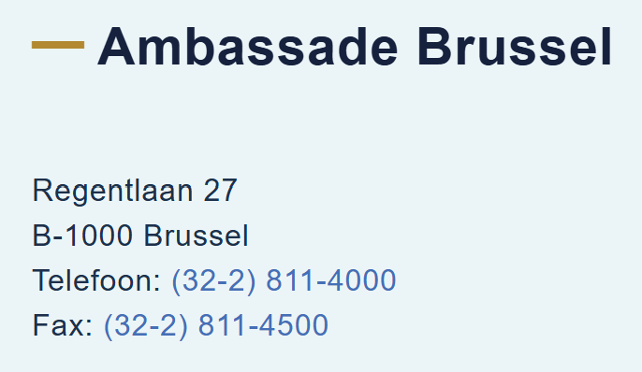
Documents to travel
International passport (valid 6 months after return, until 30/08/2027)
ESTA (visa for USA, online registration)
https://esta.cbp.dhs.gov/ (official website)
40.27 USD ~ €35,45
Non-Belgians: please contact your embassy and the American embassy in Brussels
https://be.usembassy.gov/nl/
! Entry restriction
1 march2011 – today: Iran, Syria, Libya, Somalia, Yemen, Iraq, North Korea, Soedan
1 january 2021 – today: Cuba
Apply new pasport
Go to Ambassady in Brussels
Notes:
Visum meteen aanvragen, wij zijn niet verantwoordelijk

Slide 12
Prices per person room to share
Quad room: 1005 euros
Triple room: 1085 euros
Double room: 1215 euros
*The payment will be made in 2 parts.
13 October : advance payment €620
8 December: Saldo

Slide 13

Insurances
Cancellation insurance
Optional: €60
Cancellation fee
Until 13 October => €300 (ONLY free if your ESTA is denied with evidence)
14 oct – 27 oct => €720
28 oct – 7 dec => €800
8 dec – 30 jan => full price
Travel assistance insurance (reisbijstandsverzekering)
Mandatory
  -> Protections : €56
Joker Travel Insurance: https://www.dropbox.com/scl/fi/yz6eptd039xcx6j1kjdxq/0079-8502830N-01072026-classic-25.pdf?rlkey=xlj4xl54ps2cm9umih4h3tn2o&st=kjdpu7r8&dl=0

Slide 14

TOTAL COST (WHAT IS INcLUDED?)
Flights UA + 23 kg luggage
Accommodation
5 nights
Chosen room
Transfer airport – hotel – airport

Slide 15
What’s not included?
Breakfast & Lunch & dinner
Entrance tickets for attractions
Local
Transportation
Personal expenses
Insurance
Notes:
Gerichte meerprijs is €500
Thomas more heeft geen afbetalingsplan, zorg ervoor dat als je je inschrijft dat je het kan betalen

Slide 16
Registration deadline: 13 oct
First come first serve
60 seats
https://forms.cloud.microsoft/Pages/DesignPageV2.aspx?prevorigin=shell&origin=NeoPortalPage&subpage=design&id=xTzTd7TJZkeVx-1bUV4czqzjspGJM1hKlAm0SeQa5zpURUJHWEw5SDVEQ0FQQTZWWTRSOTZJMlFVOC4u&topview=Prefill
Registered = agreed to all terms and conditions

Slide 17

Questions?

Slide 18
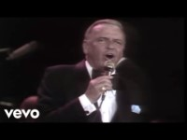
Thank you and start spreading the news!

