Slide 1

We are almost ready to start…
WELCOME!

Slide 2

NEW YORK
February 2023

Slide 3

Voorstelling van BE NY - YouTube

Slide 4


Partner in education Thomas More TRM
Dubai February 2022
Organizing tour operator

Slide 5
WHO CAN REGISTER?
Only Thomas More students
All study fields :
  Business
  Tourism
  Organisatie & management
  Ims – DSPS
  Graduaten

Slide 6
General information
Not mandatory
You will not miss classes
Between two semesters
Teachers will join
Prices are depending on room type
Max. 80 persons (already registered?)

Slide 7
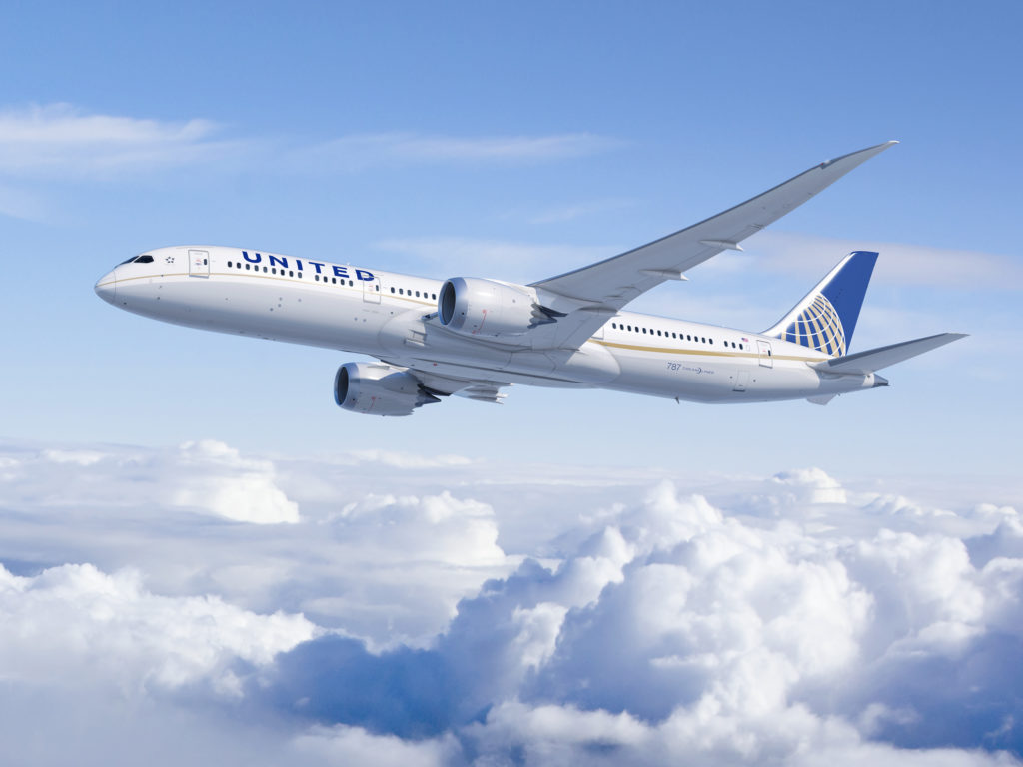
Flights
OUTBOUND 5 FEB
UA998 BRU-EWR
10.10-12.30
INBOUND 10 FEB
UA999 EWR-BRU
19.00-08.05 (11 FEB)
*Incl. 23kg luggage & taxes

Slide 8

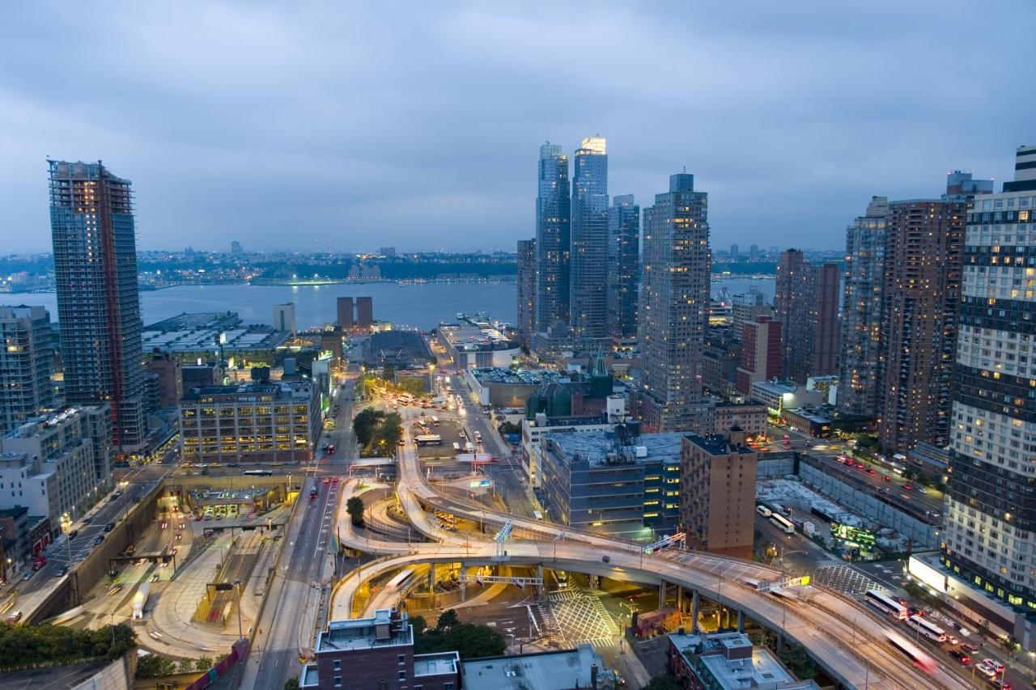
ACCOMMODATION
Hampton Inn Manhattan - Times Square South
Discover Times Square's world-famous shopping and dining on our doorstep. The Port Authority bus terminal and Penn Station are within 0.5 km. Enjoy free hot breakfast, free Wi-Fi, and access to our fitness.

Slide 9
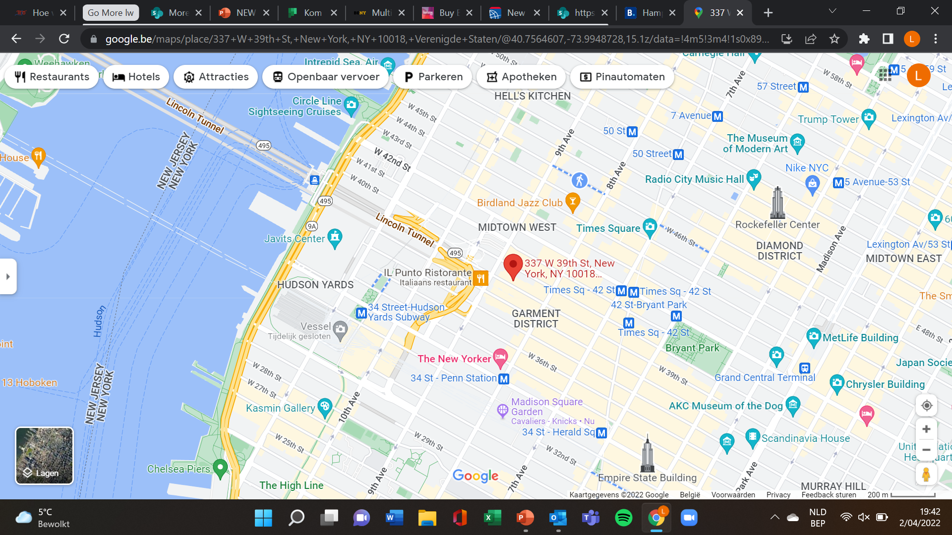
Location
337 West 39th Street, Midtown West, New York, NY 10018, Verenigde Staten
+/- 1 km away from Empire State Building
+/- 0,6 km away from Times Square

Slide 10
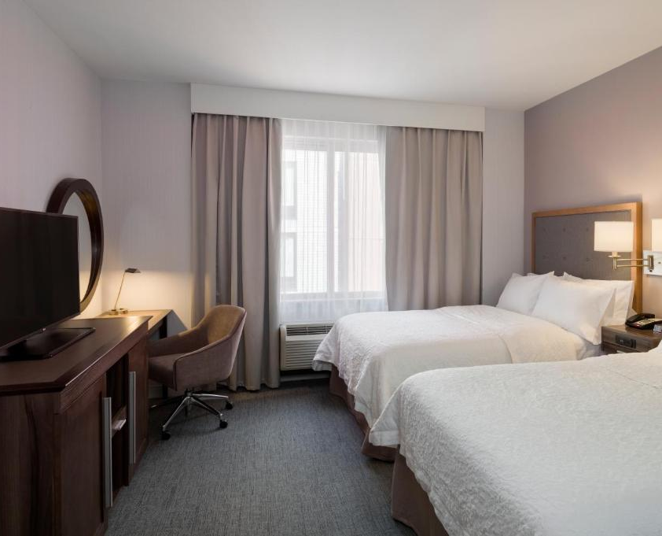
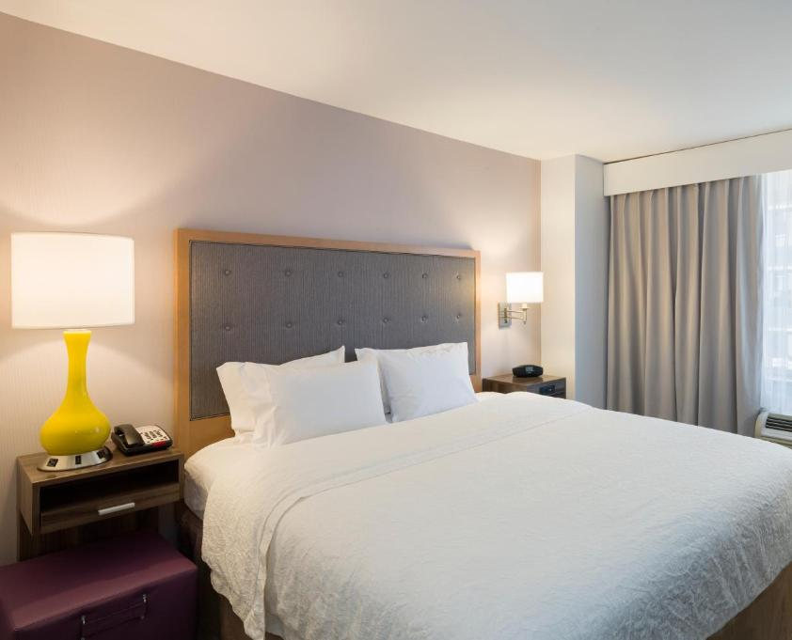
Bedroom types to choose FROM
Single room
Double room (two beds)
Double room (one bed) : approx. 1m80 width
Family room (four persons – two double beds) : approx. 1m40 width

Slide 11
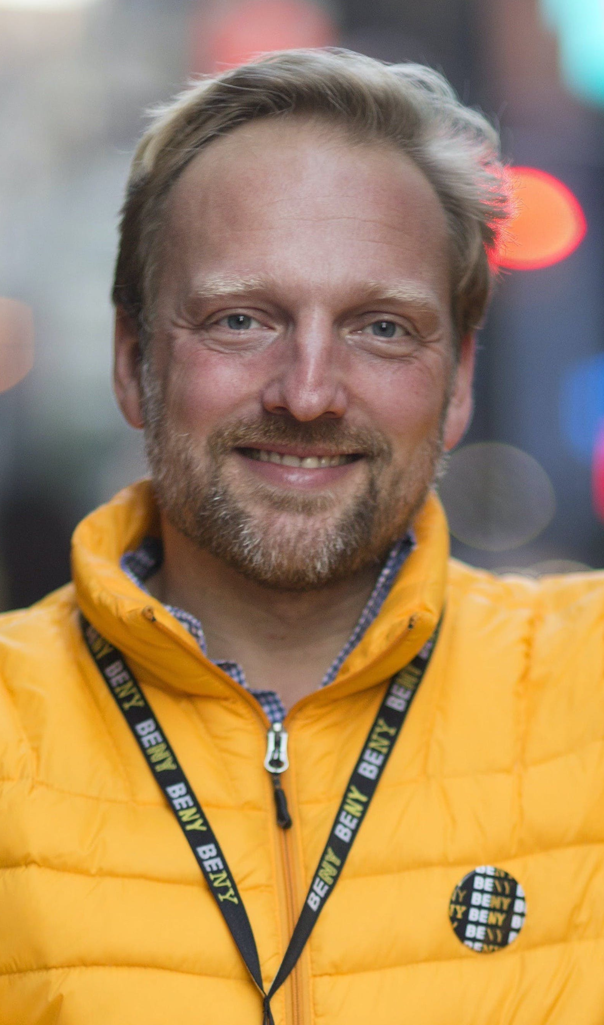

Patrick van Rosendaal
Day 1 – tour
Optional extra tours
Just landed in the City That Never Sleeps? The BE NY guide leads you past the hotspots of the heart of Manhattan. In Times Square, let yourself be overwhelmed by flashing advertising panels and discover why this is the busiest intersection in the city. Bryant Park, New York's most charming spot is close by.
Our tour ends at Grand Central Terminal where the guide tells you compelling anecdotes and introduces you to some enchanting nooks and trendy food markets. Raise your gaze to the Empire State Building, the Chrysler Building, the beautiful UN Building.... And discover with a handy trick how to orient yourself in the city from now on. This walk will have a real Thomas More touch!

Slide 12
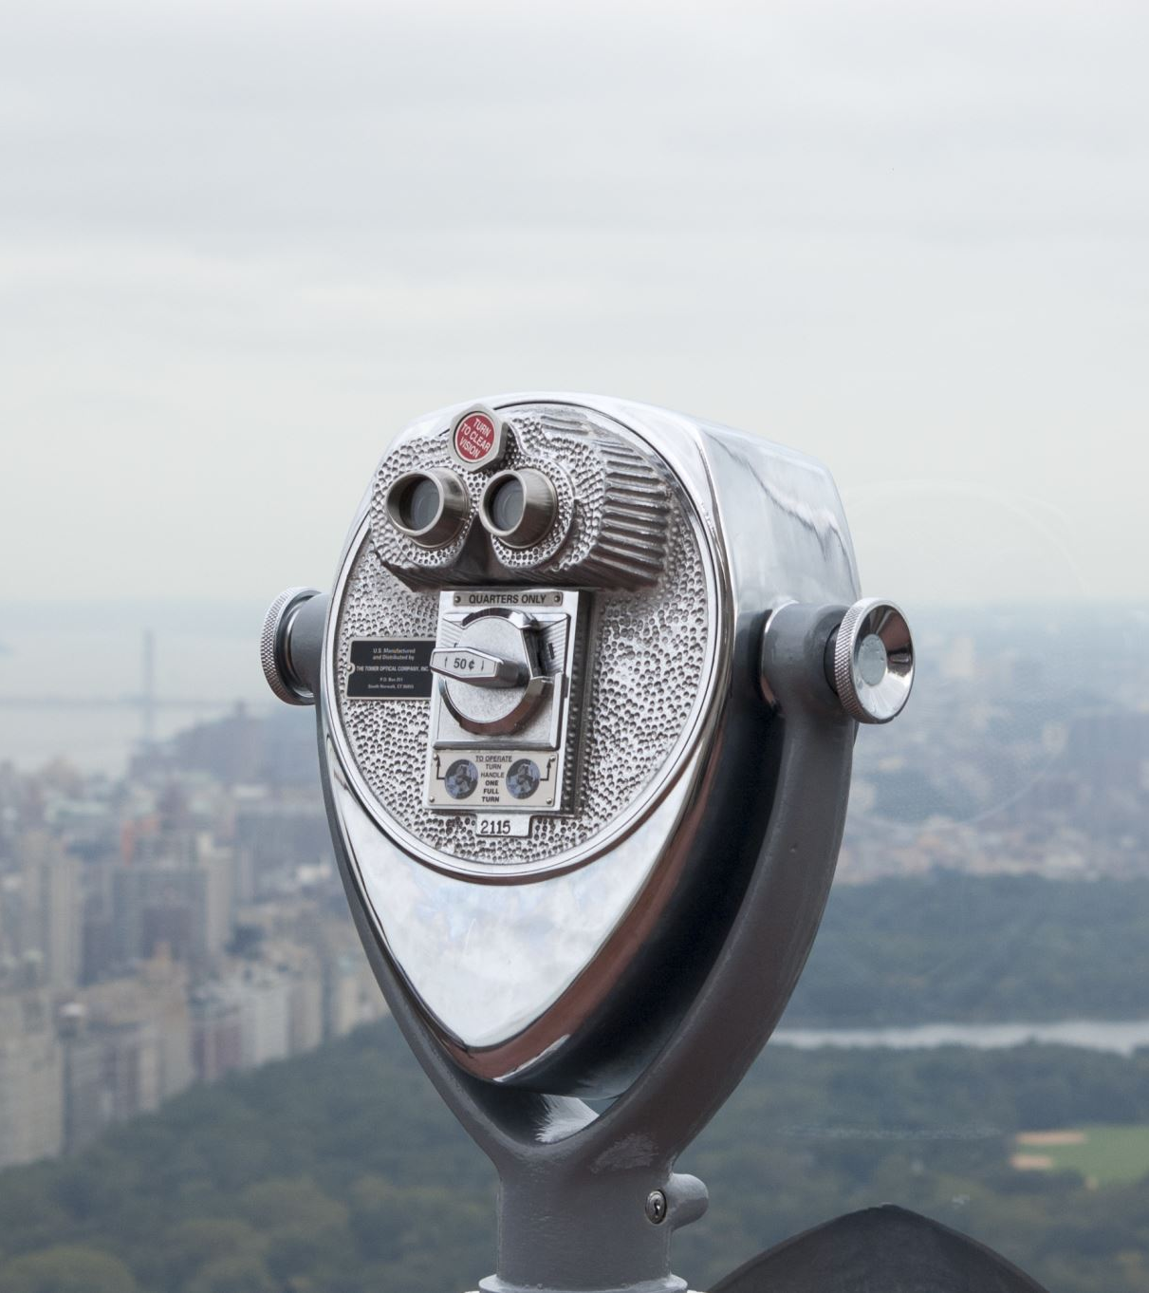
NY: student-friendly city
Many tourist attractions, museums and exhibitions free of charge or large reduced fare.
https://www.nycgo.com/articles/easy-admission-student-savings-in-nyc/
https://www.nyc-arts.org/collections/35/free-museum-days-or-pay-what-you-wish

Slide 13
C3 pass ($87)
Empire State Building
Top of the Rock Observation Deck
Ferry Access to Statue of Liberty and Ellis Island
9/11 Memorial & Museum
American Museum of Natural History
The Museum of Modern Art (MoMA)
Circle Line Sightseeing Cruises
Intrepid Sea, Air & Space Museum
Guggenheim Museum
City Cruises– Available Saturdays
Edge at Hudson Yards
https://www.citypass.com/new-york-c3

Slide 14
Documents to travel
International passport (valid 6 months after return, until 11/08/2023)
ESTA (visa for USA, online registration)
Non-Belgians: please contact your embassy
Applicable at this moment: only fully vaccinated persons can enter the US + negative PCR-test (This might change).

Slide 15
Prices per person room to share
Single room : 1449 euros
Double room (two beds) : 1155 euros
Double room (one bed) : 1069 euros
Family room (four persons – two double beds) : 925 euros
*Prices include airport taxes (€93,29). This might change a little.
*The payment will be made in 3 parts.
→ End of May, end of September, mid December

Slide 16

TOTAL COST (WHAT IS INcLUDED?)
Flights UA + 23 kg luggage
Accommodation
5 nights
Chosen room
Breakfast
Transfer airport – hotel – airport
Guided tour by BENY (3 hours)

Slide 17
What’s not included?
Lunch & dinner
Entrance tickets for attractions
Local
Transportation
Personal expenses
Insurance

Slide 18

Insurances
Cancellation insurance : 5% of total cost
In case of medical issues before departure, also includes positive PCR-test.
→Franchise fee : 25 euros
→ Cannot be added after registration
Travel assistance insurance (reisbijstandsverzekering)
Not mandatory but strongly recommended
  Thomas More (AG insurance) : 14 euros (does not cover quarantine)
  Protections : 45 euros (covers quarantine)

Slide 19
Registration
https://webforms.thomasmore.be/view.php?id=716382

Slide 20

Questions?

Slide 21
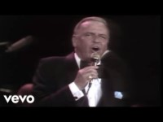
Thank you and start spreading the news!

